Slide 1
Pokemon SV Nuzlocke Tool

Slide 2

Four States (Frames)
Route Name
Route Name
Route Name
Route Name
?
Pikachu
Pikachu
Pikachu
Roll Encounter
Successful Capture
Failed Capture
Unknown Encounter
Rolled Encounter
Successful Capture
Failed Capture

Slide 3
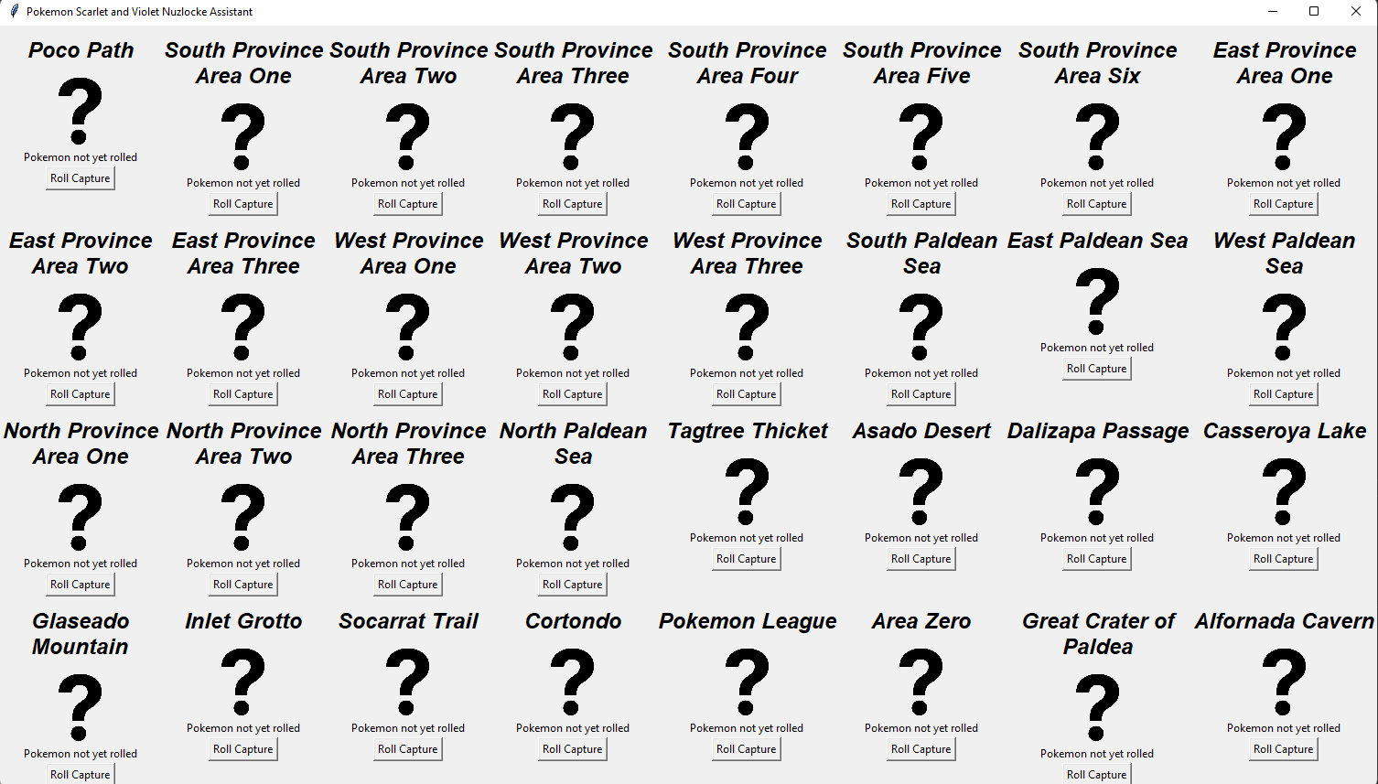
Save
Scarlet
Current Level Cap:
Violet
Lv. 15
Load

